Slide 1


Slide 2
High School Counselors & the Journey to College
Amy Burke, Head Counselor
The Gwinnett School of Mathematics, Science, and Technology
Amy_Burke@gwinnett.k12.ga.us

Slide 3
High School Counselors Role
Track student progress toward high school graduation
Meet with students to discuss post-secondary options
Provide classroom guidance, advisement lessons, and other group sessions to outline college process
Send transcripts, recommendation letters, school profiles to colleges

Slide 4
High School Counselors “Can…”
Work with families to broaden options for students
Identify safety schools and discuss realistic expectations
Help resolve issues if all efforts have been exhausted
Discuss what test might be better for a student
Send out notices for scholarships they hear about
Target students who may meet requirements for great scholarships

Slide 5
High School Counselors “Cannot…”
Go through the application step-by-step with students
Memorize every deadline for every college
Know every scholarship in the world (there are SO many!)
Force students to read/research/listen to counselors

Slide 6
High School Resources and MONEY
Find out how your counseling department sends out information – Twitter, Email, Instagram, website?
READ these notices!
Use counseling websites for other schools to see scholarship listings
Ask counselors if the scholarship seems odd
  If a scholarship application requires a fee, it might not be a good one
  Pay attention to the source

Slide 7
Timeline
College applications FIRST
  Finish at least one application by November 1
  All essays and other applications finished by Dec 1
  Pay attention to whether the school requires earlier applications for scholarship consideration.
Seeking money NEXT
  Turn focus to scholarship searches
  Spend time each week devoted to searches and scholarship applications
PARENTS and STUDENTS, complete the FAFSA beginning October 1
  Gather tax/financial documents for previous year
  Research FAFSA by going to www.fafsa.gov

Slide 8
HOPE Scholarship
Apply through GaFutures.org
Student GPA is recalculated using rules from the county or school
  Only Math, Science, Social Studies, Language Arts, & Foreign Language count
  Engineering classes may or may not be “science”
  AP classes and other weighted classes will be affected
Rigor requirements are met in Gwinnett’s traditional curriculum requirements
Two types – “regular” HOPE, and Zell Miller
  HOPE requires 3.0 GPA (recalculated)
  Zell Miller requires 3.7 GPA, and minimum SAT/ACT scores
Go to GaFutures.org to see student HOPE GPA

Slide 9
Scholarships – Types
College Based Scholarships
  Merit based offered through colleges
  Deadlines typically October/November
  Some require additional applications
Where?
  College websites, in the Financial Aid section
  Some are also listed in the Admissions section
  Try searching for "[College/University Name] Scholarships" or "[College/University Name] Financial Aid."

Slide 10
Scholarships – Types
Non-College Based Scholarships
  Community offerings, national offerings, local organizations
  Deadlines often Spring or even later!
  Found in many, many places
Where?
  Scholarship databases – tons of searchable lists
    www.goingmerry.com
    www.fastweb.com
    www.scholarships.com
  School counseling websites
  Google and other “generic searches”

Slide 11
Check These Out…
gcps-foundation.org/scholarships
  Entire list of scholarships for Gwinnett students
  Updated applications typically available in the fall.
Area PTSA Scholarships
  Some offer up to $750 scholarships PER SCHOOL for the county!
Questbridge College Match
  For low-income, high-achieving students
Gates Scholarship
  For low-income, high-achieving, minority students
Lists from local schools!
  Check other schools’ counseling pages, even out of county
Notes:
Mention Academic Common Market and “no-loan schools” – Davidson, Tufts, Washington and Lee, Vanderbilt, etc.

Slide 12
Final Thoughts…
Start this process NOW and dedicate a little time each week. Do a personal “cost-benefit analysis” to decide whether or not to apply.
Paying for college is a family decision…YOU decide what you are willing and able to afford
Discuss finances EARLY and come up with plans based on what may happen with financial aid.

Slide 14
Lawana Haynes
Assistant Director, Financial Aid - Customer Service
Program Director, Elite Scholars Program

Slide 15


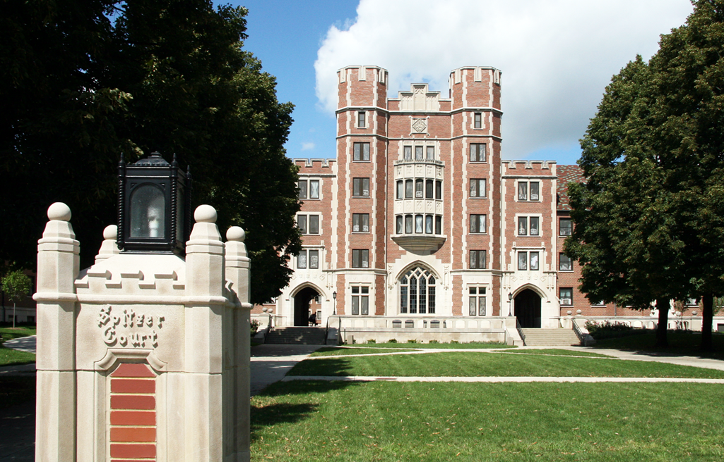


Things to know: admissions & scholarship

Slide 16

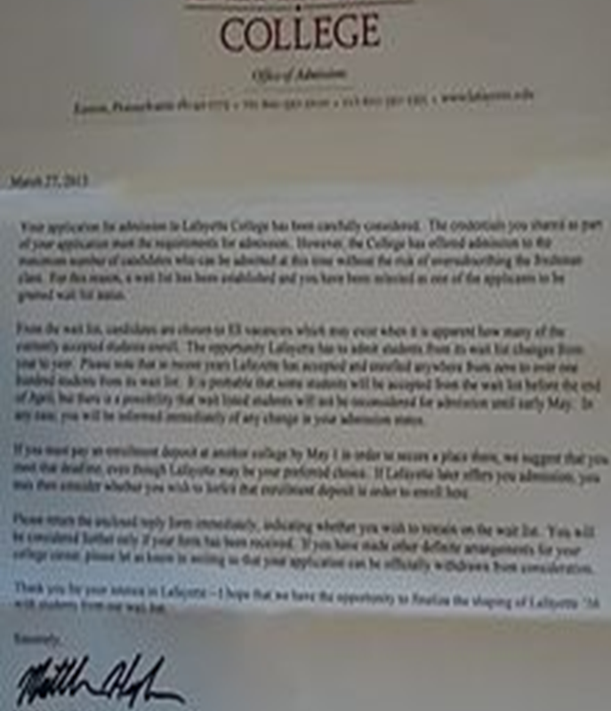

Admissions process

Slide 17







scholarships

Slide 18
resources
FastWeb.com
GAcollege411.org
ScholarshipExperts.com
CollegeBoard.com
Community organizations (local businesses)
FAFSA is open as of October 1st using 2018 taxes – StudentAid.gov

Slide 20

DUAL ENROLLMENT
Karen Howell
Director of Dual Enrollment
Khowell@GwinnettTech.edu
GwinnettTech.edu/DualEnrollment

Slide 21
DUAL ENROLLMENT
Earn college credits that are also applied towards high school graduation

Slide 22
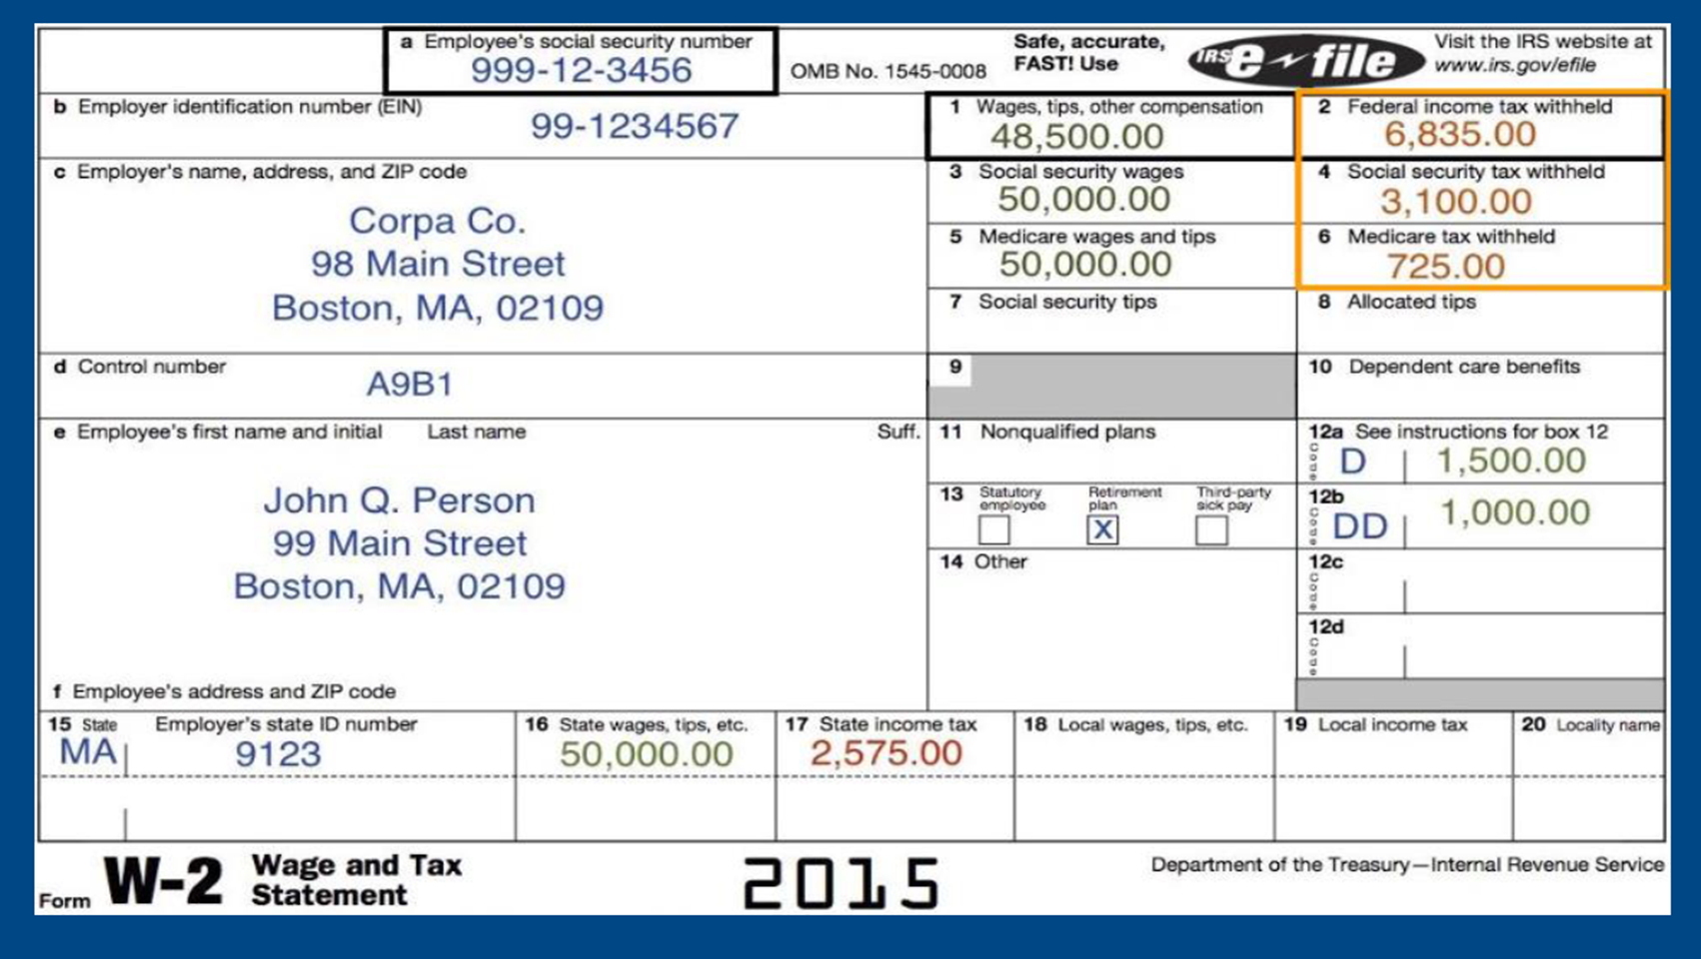


Slide 23

1
Notes:
1 College Class = 1 Semester = 1 HS unit

Slide 24


  0
Notes:
No Tuition, mandatory fees, textbook fees.

Slide 25


3
Notes:
3 things to qualify to participate: attend HS in GA. Be in grades 9 – 12. Get accepted to the college.

Slide 26

28
Notes:
Transfer courses

Slide 27

WHEN & WHERE
Notes:
Fall, spring, summer
Morning, afternoon, evening, Saturdays
On campus, Online, at a partnered HS

Slide 28
FACTS & FIGURES
2,050
Notes:
Fall 2019 data: 2,050 students, approx. 100 are home-study
22% of total enrollment = DE.
66 HS (public, private, home-study).
35 different Majors

Slide 29
CONTACT US
  GwinnettTech.edu/DualEnrollment
  DualEnrollment@GwinnettTech.edu

Slide 31
Financial Aid Resources
By: Hal Wilkinson

Slide 32

Direct and Indirect Costs
Direct Costs
Tuition and fees
On campus housing
Meal plan
Parking permits
Indirect Costs
Books
Rent for off campus housing
School supplies
Groceries
Notes:
Direct costs are paid directly to the institution. Some of these costs include: tuition and fees, on-campus housing, meal plan, and possibly even parking permits.
Indirect costs are expenses paid while a student is enrolled but the costs are not billed from the institution. Some examples are listed here.
Can you think of others? Feel free to give some examples in the chat box.
(Presenter: be sure to read some of their responses: bedding, cell phone bill, gas, entertainment, etc.)

Slide 33

Sources of Financial Aid
State Government
Colleges and Universities
Employers and Private Companies
Professional and Service Organizations
Private Foundations
Federal Government
Notes:
Financial aid can come from many different sources.
The most common include federal and state government, as well as colleges and universities.

Slide 34

Helping Outstanding Pupils Educationally Program
HOPE Scholarship
Zell Miller Scholarship
HOPE
Grant
HOPE
GED Grant
HOPE Career Grant
Zell Miller Grant
Notes:
Think of the HOPE Program as a family and the Georgia Lottery as the parent. The HOPE Program provides money to assist students with their educational costs.
click

Slide 35
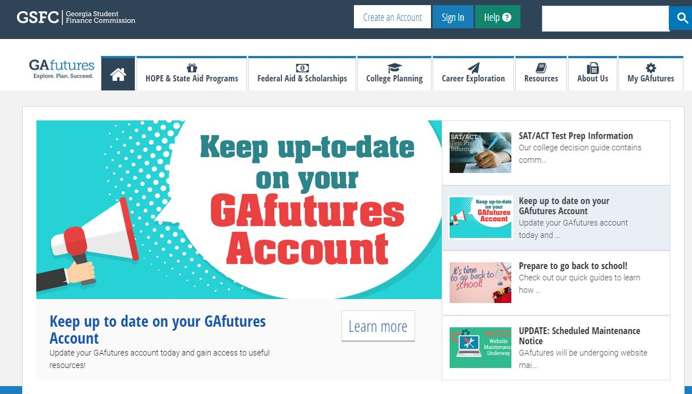
GAfutures.org
Georgia’s primary resource to help students plan, apply and find affordable ways to pay for college

Slide 36



GAfutures.org
Financial Aid & Scholarships
  The basics, state and federal programs, calculators, repayment options, financial literacy tips, national scholarship search
College Planning Tools
  Grade-specific checklists, College Money Matters, calculators, applications (admissions, financial aid), HOPE-eligible institutions highlighted, national college search
Career Exploration
  Career assessments, interest profiler, Career Clusters and Pathways, skilled trades

Slide 37
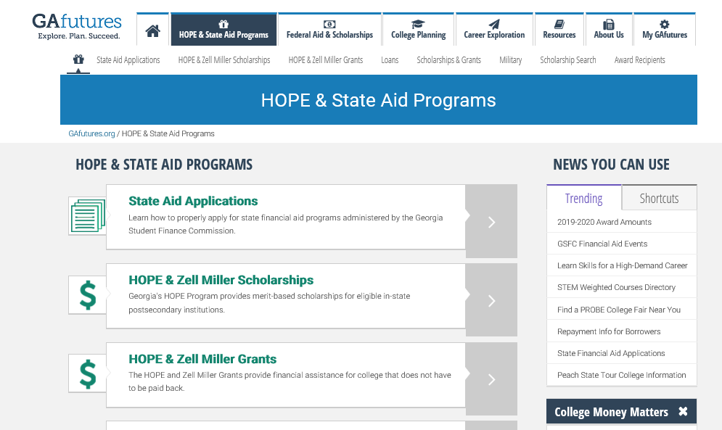
HOPE & State Aid Programs

Slide 38
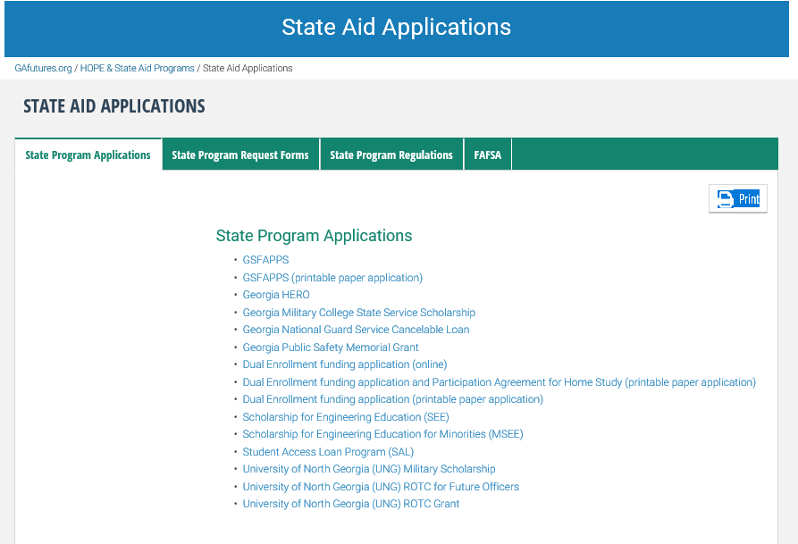
State Aid Applications

Slide 39
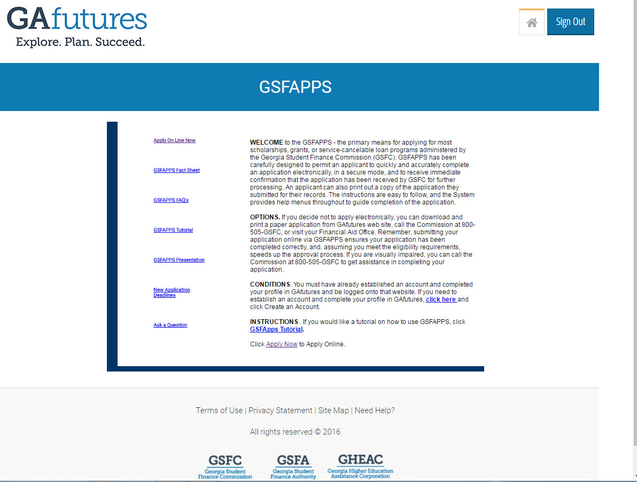
GSFAPPS
Notes:
If you choose to complete a GSFAPPS, students can access the application through their My GAfutures account.

Slide 40
Federal Aid Programs
Notes:
It is important to know how the aid is funded.

Slide 41
Federal Aid (Grants)
Pell Grant
  Undergraduate student with financial need
  Maximum amount for 2019-2020 is $6,195
Federal Supplemental Educational Opportunity Grant (FSEOG)
  Undergraduate student with exceptional financial need
  Pell Grant recipients receive priority
  Up to $4,000
Notes:
The federal government has financial aid programs that include grants and work-study awards that do not need to be repaid, as well as various loans that require repayment. For more information, visit studentaid.gov

Slide 42
Federal Aid (Loans)
Direct Subsidized Loan
Direct Unsubsidized Loan
Federal PLUS Loan – for parents of undergraduate students
Grad PLUS Loan – for graduate and professional students
Notes:
The FAFSA also determines the amount of loans, subsidized and unsubsidized, you are eligible for.
These loans, of course, will have to be repaid once you are no longer in school. Repayment begins six months after graduation or if the student is no longer enrolled at least half time.
Federal PLUS Loans are unsubsidized loans made to parents of undergraduate students. If your parents cannot obtain a PLUS loan, you may be eligible to borrow additional Unsubsidized Stafford loan funds. The interest rates may vary based on when the loan is borrowed.
With the Grad PLUS Loan, graduate and professional students are also eligible to borrow under the PLUS Loan program to help pay for their education.

Slide 43
Factors that Influence EFC
Family Size
Number in
College
Independent vs. Dependent Student
EFC
Income (Student/Parent)
Assets
Savings
Notes:
EFC is influenced by a number of factors that both you and your parents provide on the FAFSA.

Slide 44


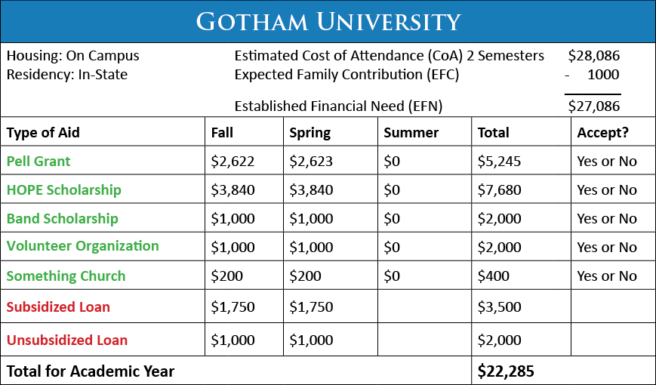
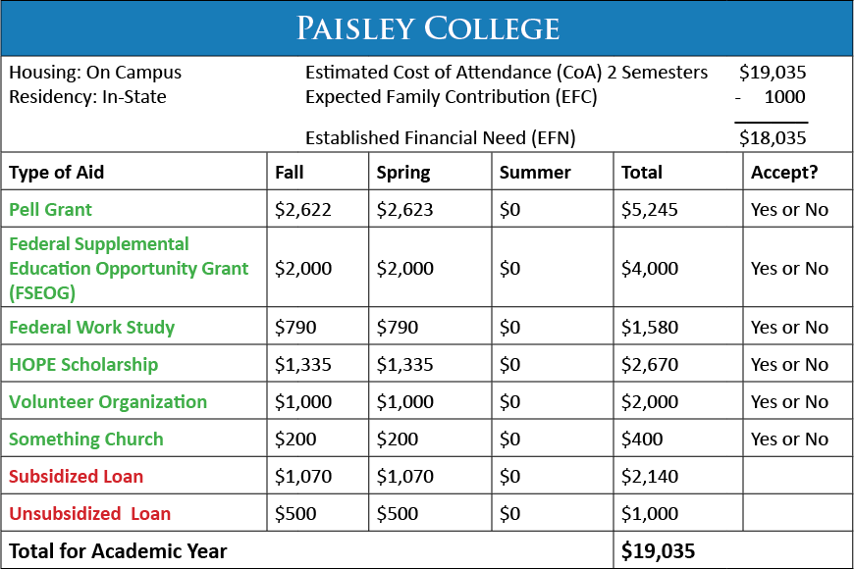
Compare Award Offers
Notes:
Here are two examples of award offers received by a student.

Slide 45
Completing the FAFSA
Notes:
With each type of aid there is an application process. It would be amazing if there was one application for all the financial aid, but like most things…it can’t be that easy. Let’s work through each process.

Slide 46

Completing the FAFSA
(Free Application for Federal Student Aid)
First step in financial aid search
Application is free
FAFSA for upcoming aid year opens October 1st
Begin by creating your FSA ID
  Allows you to sign your FAFSA
  If dependent student, parent will also need an FSA ID
Find a FAFSA Completion event if you need help
  Check with your school counselor for financial aid nights or FAFSA workshops
  Visit GAfutures for events near you
Do not pay anyone to complete FAFSA for you
Notes:
The first step in your search for financial aid both federal and state, is to complete the Free Application for Federal Student Aid (FAFSA). Submitting a FAFSA is free and starts with creating your FSA ID. Your parent may also need an FSA ID as well if you are a dependent student.
If you need help, check with your school counselor about financial aid nights or FAFSA Completion events near you. Visit Gafutures.org for more information.

Slide 47
FAFSA Assistance for October
October 19,2019
South Gwinnett High
10:00 to 12:00
October 26,2019
Berkmar High
9:00 to 12:00
October 14,2019
Meadowcreek High
5:30 to 7:00
October 24,2019
Lanier High
6:00 to 8:00
October 22,2019
Mill Creek High
6:00 to 8:00
October 26,2019
Central Gwinnett High
9:00 to 12:00
October 29,2019
Duluth High
5:00 to 7:00

Slide 48

Scholarships and Grants
Scholarship examples:
Height
Ethnicity
Religious affiliation
Gender
Being a multiple (twin, triplet, etc.)
Left-handed
Video on social media
Grants:
Need-based
Notes:
It is always best to first utilize money that doesn’t have to be repaid such as scholarship and grants.
A scholarship is a type of financial aid that is typically awarded based on a student’s GPA and/or test scores. But don’t let that limit the search. Many can be found based on a variety of criteria.
Most grants on the other hand are need-based, which means they are usually awarded to student’s with high financial need. We will talk more about need-based aid later.

Slide 49



Duct Tape Scholarship
To enter the Duct Tape Scholarship, you and your partner must be legal residents and at least 14 years old. Either opposite sex or same sex partners may participate. You must attend a high school prom and have your photo taken before, during or after the prom in your attire made using duct tape.
Costumes must be original and will be judged based on workmanship, originality, use of color, use of accessories, and use of duct tape.
Photos of the 10 finalist couples will be posted online for online voting.
For more information about the Duct Tape Scholarship Contest see, duckbrand.com

Slide 50
Tuition Assistance
Bank of America
Dollar General
Chilis
United Postal Service
QT ( Gas Station)
Racetrac
Kroger's
Publix
Sprouts
Wells Fargo
TGI Fridays

Slide 51
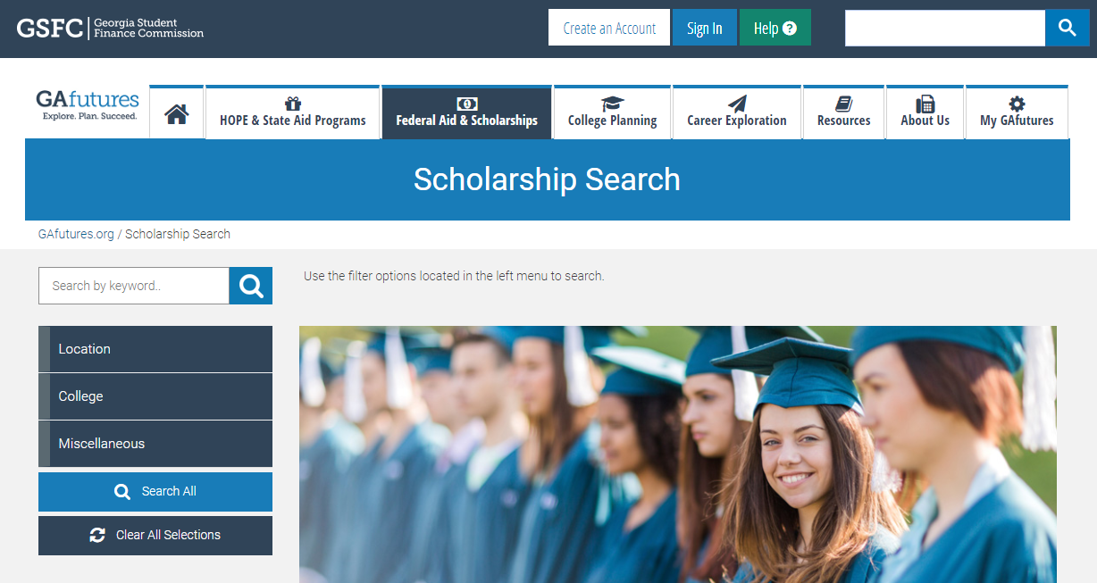
Scholarship Search
Notes:
The Scholarship Search uses a national database that can be searched by key word or you can use various filters to help narrow down your search.

Slide 52

Additional Scholarship Resources
www.fastweb.com
www.collegeboard.com
www.finaid.org/scholarships
UNIGO.COM

Slide 53


Contact Us
800.505.4732
HalW@gsfc.org
Notes:
You can also call our 800 number or email our Outreach Services with any questions you may have.

Slide 54



Be Social
Notes:
You can follow us on our GAfutures Facebook, Twitter and You Tube for all the latest and greatest information about financial aid – tips, resources, reminders, and more.

Slide 55
Our Mission
To promote and increase access to education beyond high school for Georgians

Slide 56
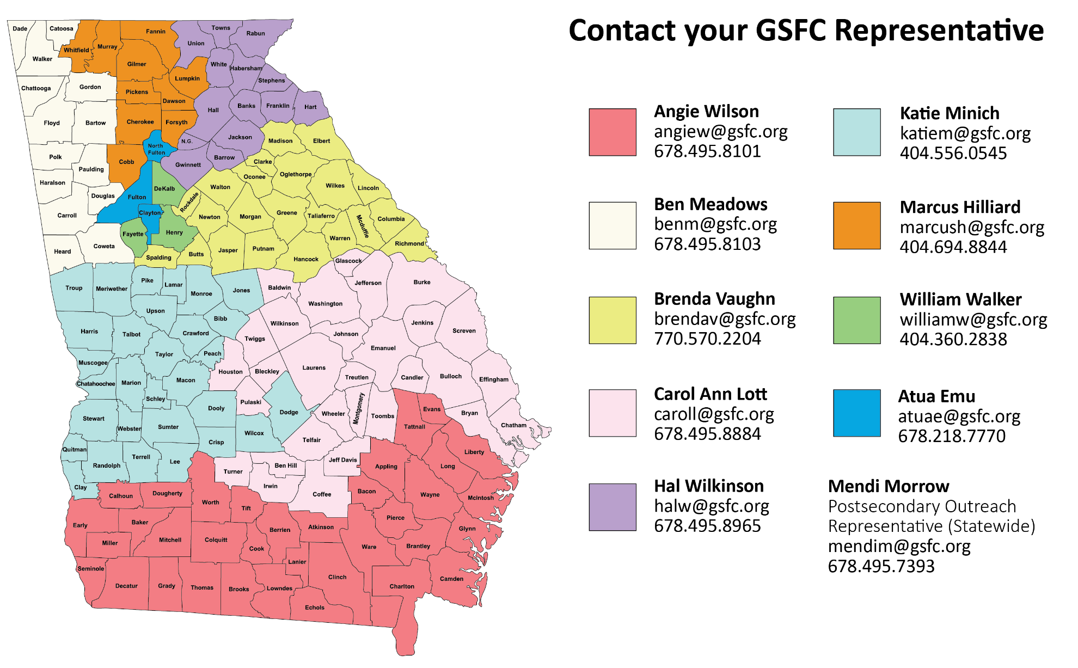
We’re Here to Help You
Notes:
We currently have nine representatives across the state that are here to help you.
Please do not hesitate to contact any of us.

